Slide 1
Group 7 Project Presentation
Daniel Arcega, Duc-Viet Hoang , Sam Whitney

Slide 2
Garbage Classification Dataset
Garbage Classification, by Hassnain Zaidi, from kaggle.com
Downloaded using kaggle’s API using mlcroissant
Consists of 2527 images across 6 classes:
Paper - 594 images
Glass - 501 images
Plastic - 482 images
Metal - 410 images
Cardboard - 403 images
Trash (Mixed or non-recyclable waste) - 137 images
Notable class imbalance (Paper is ~ 4.34 times the size of trash)

Slide 3
Related Dataset Complications
Description mismatch
12 categories (glass color, shoes, batteries, etc) → 6 categories
Duplicated data for training, testing and validation → Manual splitting.

Slide 4
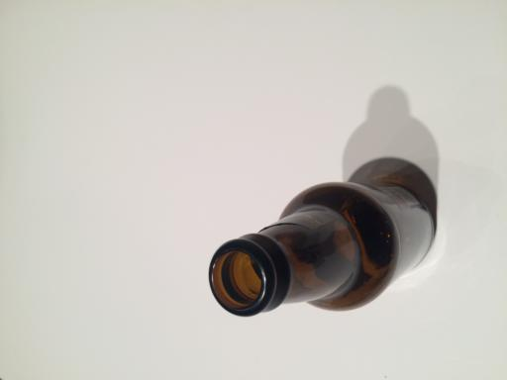
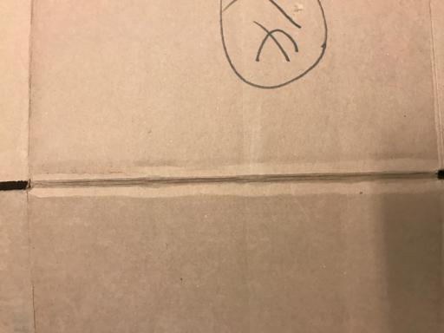
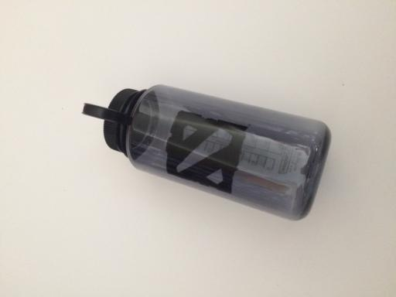
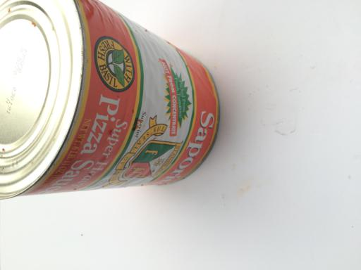
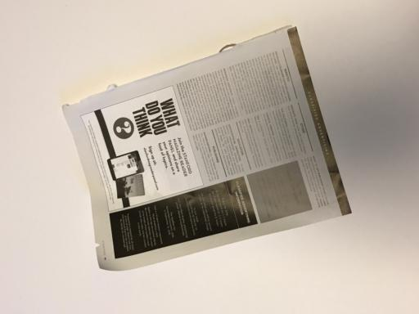

Example
Glass
Cardboard
Plastic
Metal
Paper
Mixed

Slide 5
Preprocessing
Tasks handled by preprocessing:
Standardization of image size
Splitting single image set into training/testing/validation sets
Augment training count and resolve class imbalances
Normalize lighting and enhance contrast for feature extraction
Prevent overfitting by handling orientation, source sampling/lighting variation

Slide 6
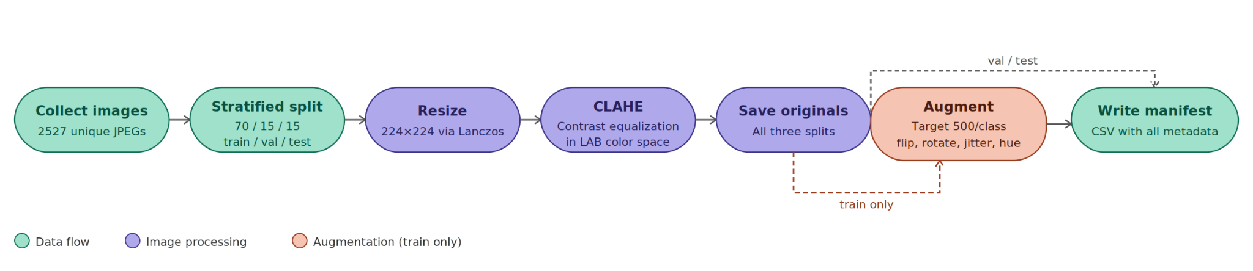
Preprocessing Pipeline

Slide 7
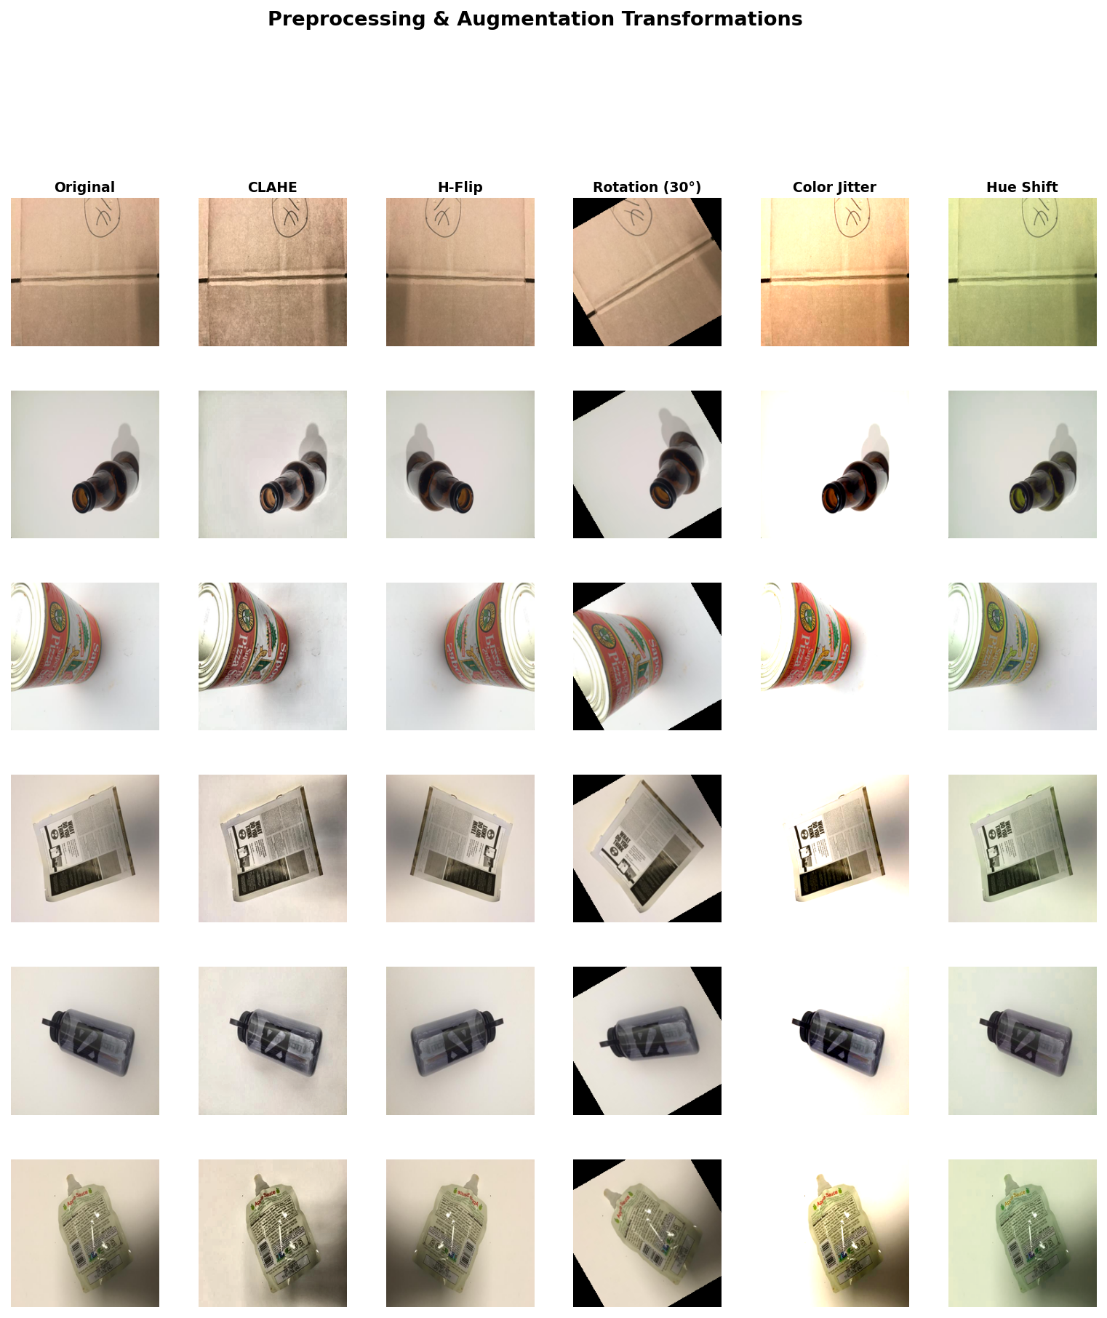

Slide 8
Methodology: k-NN
Hyperparameter Tuning (k):
Evaluate k in the range 1 to 49 (odd)
Select the value of k that achieves the highest F1-score on the validation set
Final Evaluation:
Apply the selected k to the test set
Report the test performance (e.g., accuracy, F1-score)

Slide 9
Methodology: CNN
Architecture:
3 Convolution Blocks:
Conv(3 → 32) + BatchNorm + LeakyReLU + MaxPool
Conv(32 → 64) + BatchNorm + LeakyReLU + MaxPool
Conv(64 → 128) + BatchNorm + LeakyReLU + MaxPool
AdaptiveAvgPool2d → (5 × 5) → 128 × 5 × 5 = 3200 features
Fully Connected Layers: 3200 → 256 → 128 → 64 → 6 (output)
Dropout: 0.1
Training Strategy:
Monitor loss on the validation set
If no improvement for 3 epochs → Reduce learning rate by half
If no improvement for 5 epochs → Stop training (early stopping)

Slide 10
Methodology: SVM
Architecture:
Feature Extraction:
HOG Feature Extraction
Global Color Histogram
Color-HOG Feature Concatenation
2x2 - 3x3 Spatial Color Histogram
Saturation-weighted Hue Histogram
2x2, 3x3 - Saturation Feature Concatenation
Dimensionality Reduction
PCA Application: 1792 Components → 591
Classifier
SVM: try linear, polynomial, RBF kernels
Training Strategy:
Test all feature-set permutations all classifier C/gamma/dimension settings using GridSearchCV
Parameter grid selects best feature set with best parameter performance in training/validation phase
Makes final evaluation on hold-out testing set

Slide 11
SVM Training Metrics
Feature Mode | Best Kernel | Accuracy | Precision | Recall | F1
HOG | Polynomial | 0.5884 | 0.6870 | 0.5523 | 0.5701
Color | Polynomial | 0.7731 | 0.7715 | 0.7568 | 0.7629
HOG-Color | Linear | 0.6253 | 0.6113 | 0.6074 | 0.6079
2x2 Color | Polynomial | 0.8021 | 0.7890 | 0.7989 | 0.7917
3x3 Color | RBF | 0.8047 | 0.8063 | 0.8078 | 0.8055
Saturation - weighted Hue | Polynomial | 0.6253 | 0.6107 | 0.5941 | 0.5886
Sat-3x3 | RBF | 0.8074 | 0.8077 | 0.8097 | 0.8073

Slide 12
Results
 | Accuracy | Precision | Recall | F1 Score
Logistic Regression | 25.33% | 0.261 | 0.262 | 0.250
k-NN | 29.82% | 0.285 | 0.312 | 0.284
CNN | 73.35% | 0.722 | 0.710 | 0.709
SVM-Spatial 3x3, Saturation - weighted Hue | 80.00% | 0.7807 | 0.7925 | 0.7844

Slide 13

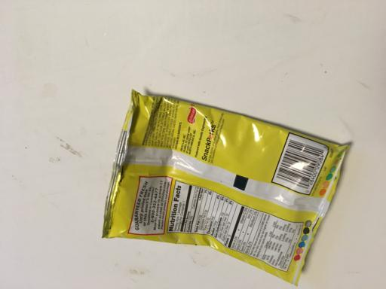
Problem
Why does CNN not achieve high performance?
Dataset limitations
Visually similar classes (hard to distinguish) → “Mixed” category
Paper?
Plastic?

Slide 14
Thank you for your attention
Q&A

